Slide 1






SEMINAR
Presentation

Slide 2

Shri Sant Gajanan Maharaj College Of Engineering
Shegaon
Department of Computer Science And Engineering
Seminar
on
Decentralized Voting System using Blockchain
Academic Year 2023-24
Project Guide:
Dr. J. M. Patil
(HOD CSE Department)
Submitted by:
Yash Kumar Sugandhi (78)

Slide 3

Abstract
Introduction
Problem Statement
Aim
Objectives
Literature Survey
System Architecture
System Workflow
Proposed Algorithm
Result
Conclusion
References
Contents

Slide 4


Abstract
An electoral system or voting system is a set of rules that determine how elections and referendums are conducted and how their results are determined. Current voting systems like ballot box voting or electronic voting suffer from various security threats such as DDoS attacks, polling booth capturing, vote alteration and manipulation, malware attacks, etc. and also require huge amounts of paperwork, human resources, and time. This creates a sense of distrust among existing systems. The microchip or server can be hacked. Blockchain voting, if implemented properly, can boost voter turnout and offer more accessible and transparent elections. Citizens can easily cast their votes via their personal computers or mobile phones after completing identity verification. Voting records are easily verifiable, and vote tallying is conveniently confirmed in real-time on the network. Blockchain voting saves time, reduces costs, and paves a path for direct democracy. It uses peer to peer network, so no centralized authority.

Slide 5

Introduction
Electronic voting systems have been the subject of active research for decades, with the goal to minimize the cost of running an election, while ensuring the election integrity by fulfilling the security, privacy, and compliance requirements. Replacing the traditional pen and paper scheme with a new election system has the potential to limit fraud while making the voting process traceable and verifiable.

Slide 6

Problem Statement
To create a system that caters the problem of current voting system like ballot box voting or electronic voting. Which suffer from various security threats such as DDoS attacks, polling booth capturing, vote alteration and manipulation, malware attacks, etc. and also require huge amounts of paperwork, human resources, and time spent during voting in long queues.

Slide 7


Based on media reports, there have been approximately 10 cases of alleged EVM fraud in India from 2006 to 2018.
The following are some examples of media reports on alleged EVM fraud in India:
In 2007, The Times of India reported on a case of alleged EVM fraud in the Uttar Pradesh assembly elections. The report claimed that EVMs in some polling stations had been tampered with to favor a particular candidate.
In 2014, the Indian Express reported on a case of alleged EVM fraud in the Lok Sabha elections. The report claimed that EVMs in some polling stations had been rigged to favor a particular party.
In 2017, the BBC reported on a case of alleged EVM fraud in the Uttar Pradesh assembly elections. The report claimed that EVMs in some polling stations had been tampered with to favor a particular candidate.
In 2018, the Hindustan Times reported on a case of alleged EVM fraud in the Madhya Pradesh assembly elections. The report claimed that EVMs in some polling stations had been tampered with to favor a particular candidate.
Cases of EVM fraud

Slide 8


Project Aim
The Aim of this project is: To create a voting system sitting on the Ethereum blockchain where every vote is like a token and there are a set number of tokens in circulation based on the number of voters. The candidates with such accountability and transparency are achieved.

Slide 9
Ojectives
To limit voting fraud.
To avoid long queuing to cast votes.
To minimize the cost of elections.
To enable voters to vote in the comfort of their home, or worldwide.
To be able to verify if a vote has been counted.
To maintain transparency and anonymity in elections

Slide 10
Literature Survey
Sr no | Source (2023) | Paper Title | Outcomes/Findings | Limitation
[1] | P. Rajendra Prasad and R. Z. Ahmed (IEEE) | Secured E-Voting System Implementation Using Block-Chain Network | The proposed blockchain-based e-voting system is secure, transparent, and tamper-proof. | The system still needs to be developed further to make it more user-friendly
[2] | S. Khedkar, K. Mahajan and M. Shirole (ICBIR) | Optimization of Blockchain Based E-voting | The system is capable of handling a large number of votes without compromising security | The system needs to be tested on a large scale to ensure that it is scalable
[3] | A. Balti, A. Prabhu, S. Shahi, et.al (ICSCSS) | A Decentralized and Immutable E-Voting System using Blockchain | The system is more resistant to attack than traditional e-voting systems. | The system needs to be further analysed to address the security risks

Slide 11
Sr no | Source (2023) | Paper Title | Outcomes/Findings | Limitation
[4] | S. Goswami, R. Pandey, S. Nagar, et.al (ICSCCC) | Blockchain based voting system - A Review | The system can be automated using smart contracts, which reduces the risk of human error | There are likely to be bugs and security vulnerabilities
[5] | S. N, G. S, S. E and V. K (ICAECA) | E - Voting Using Blockchain | The use of encryption to secure the ledger. This ensures that only authorized voters can view their own votes. | The system requires a high level of technical literacy from voters
[6] | P. Kadam, P. Nikam, H. Raut, et.al (CONIT) | Blockchain Based e-Voting System | The system can be used to vote on a variety of issues, not just elections | The cost of setting up and maintaining a blockchain-based e?voting system can be high.

Slide 12
Sr no | Source (2023) | Paper Title | Outcomes/Findings | Limitation
[7] | Y. Li, Y. Li, T. Hong, et.al (IEEE) | Design and Implementation of Blockchain-based Anonymous Electronic Voting System | The system can be used to vote anonymously, which protects voter privacy. This could encourage more people to vote | The system can be complex to set up and use, which can be a barrier to adoption.
[8] | S. B. Gopal, M. Jayaprasath, C. Poongodi, et.al (ICSCDS) | Blockchain based E-Voting Application – A Survey | The system may not be accessible to everyone, such as people who do not have access to the internet or computers | The system may not be accessible to everyone, such as people who do not have access to the internet or computers.
[9] | Y. A. F. Ali, O. T. M. Ahmed, M. A. M. Diab, et.al (AiSC) | Blockchain-Based Online E-voting System | The system can be vulnerable to security risks, such as hacking and data breaches | The system can be vulnerable to security risks, such as hacking and data breaches.

Slide 13
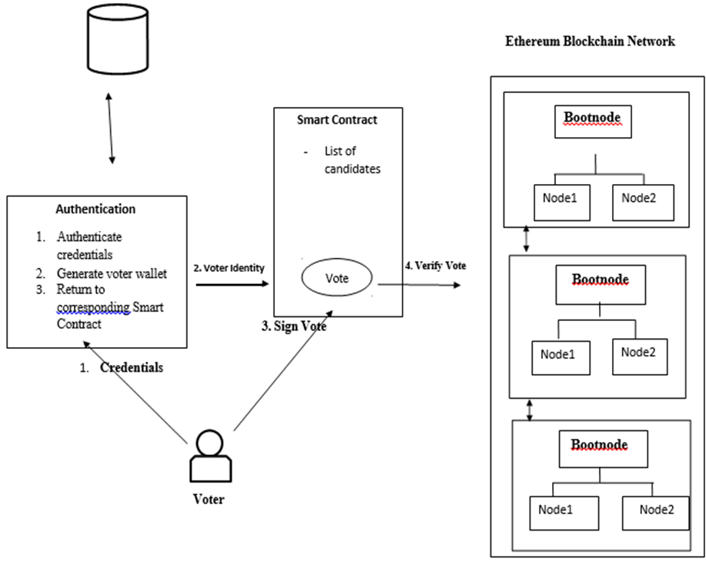
System Architecture

Slide 14
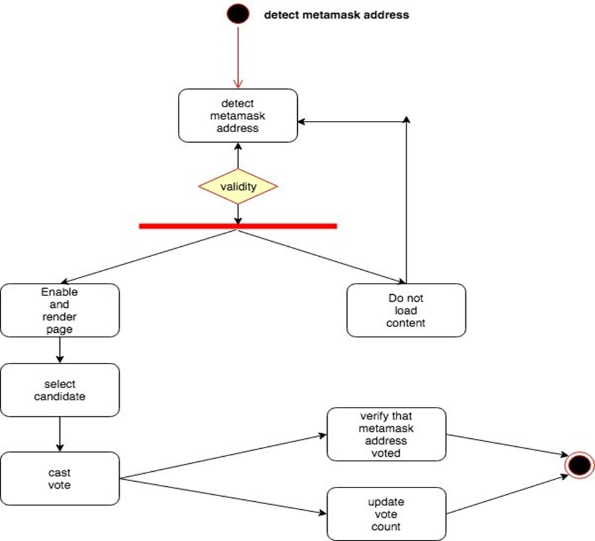
System Workflow
Activity Diagram

Slide 15
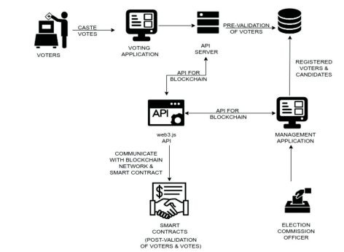
Process Flow

Slide 16
Proposed Algorithm
// SPDX-License-Identifier: MIT
pragma solidity ^0.8.0;
contract VotingSystem {
address private owner;
struct Candidate {
string name;
uint256 voteCount;
}
mapping(address => bool) private hasVoted;
mapping(address => Candidate) private candidates;
constructor() {
owner = msg.sender;
}

Slide 17
function addCandidate(string memory _name, address _candidateAddress) public {
require(msg.sender == owner, "Only the owner can perform this action.");
candidates[_candidateAddress] = Candidate(_name, 0);
}
function vote(address _candidateAddress) public {
require (!hasVoted[msg.sender], "You have already voted.");
hasVoted[msg.sender] = true;
candidates[_candidateAddress].voteCount++;
}
function getData(address _candidateAddress) public view returns(string memory,uint){
require(msg.sender == owner, "Only the owner can perform this action.");
return (candidates[_candidateAddress].name,candidates[_candidateAddress].voteCount);
}
}

Slide 18
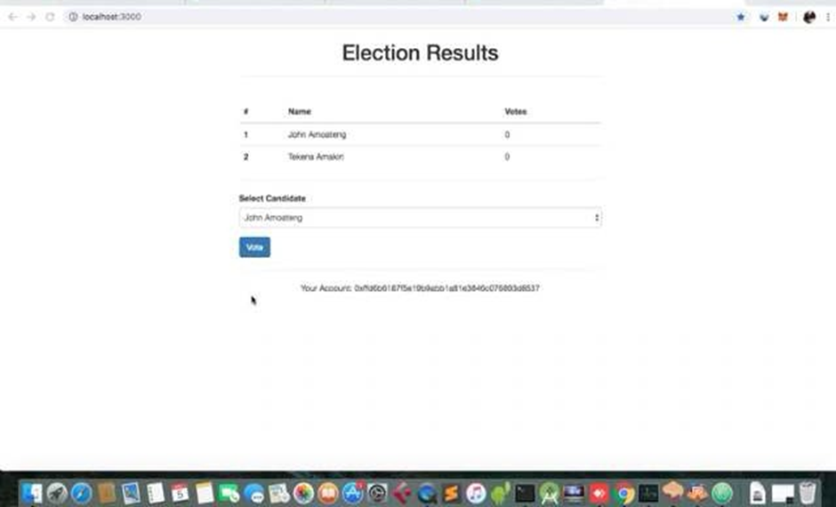
User Interface

Slide 19



Tools and Technology
React js
Node js
Solidity
MERN Stack
Blockchain
Ethereum
Metamask

Slide 20
Result
Blockchain voting, if implemented properly, can boost voter turnout and offer more accessible and transparent elections. Citizens can easily cast their votes via their personal computers or mobile phones after completing identity verification. Voting records are easily verifiable and vote tallying is conveniently confirmed in real-time on the network. Blockchain voting saves time, reduces costs, and paves a path for direct democracy.
A 1% attack is a potential threat to our proposed design. The basis of the attack being that someone could theoretically control a majority of the digital voting mining hash-rate, leading to them being able to manipulate the public ledger. The chances of this type of attack occurring are slim due to the immense cost needed to purchase hardware capable of this scale of processing

Slide 21
Conclusion
The current voting system can be improvised and secured by applying a web based voting solution. Blockchain technology has potential to be implemented in a far more secure and accessible voting system. The proposed blockchain-based e-voting system manages the election process, which makes the voting process simpler, voters can just simply login and exercise their right to vote. We believe that blockchain based voting systems can replace the traditional voting system in future. With the risks of terrible poor key management and the possibility of serious failures, blockchain voting still has a long way to go before large-scale application

Slide 22
References
[1] P. Rajendra Prasad and R. Z. Ahmed, "Secured E-Voting System Implementation Using Block-Chain Network," 2023 IEEE International Conference on Electronics, Computing and Communication Technologies (CONECCT), Bangalore, India, 2023, pp. 1-6, doi: 10.1109/CONECCT57959.2023.10234779.
[2] S. Khedkar, K. Mahajan and M. Shirole, "Optimization of Blockchain Based E-voting," 2023 8th International Conference on Business and Industrial Research (ICBIR), Bangkok, Thailand, 2023, pp. 700-705, doi: 10.1109/ICBIR57571.2023.10147663.
[3] A. Balti, A. Prabhu, S. Shahi, et.al, "A Decentralized and Immutable E-Voting System using Blockchain," 2023 International Conference on Sustainable Computing and Smart Systems (ICSCSS), Coimbatore, India, 2023, pp. 1434-1439, doi: 10.1109/ICSCSS57650.2023.10169552.
[4] S. Goswami, R. Pandey, S. Nagar, et.al, "Blockchain based voting system - A Review," 2023 Third International Conference on Secure Cyber Computing and Communication (ICSCCC), Jalandhar, India, 2023, pp. 433-438, doi: 10.1109/ICSCCC58608.2023.10176665.

Slide 23
[5] S. N, G. S, S. E and V. K, "E - Voting Using Blockchain," 2023 2nd International Conference on Advancements in Electrical, Electronics, Communication, Computing and Automation (ICAECA), Coimbatore, India, 2023, pp. 1-4, doi: 10.1109/ICAECA56562.2023.10199732.
[6] P. Kadam, P. Nikam, H. Raut, et.al, "Blockchain Based e-Voting System," 2023 3rd International Conference on Intelligent Technologies (CONIT), Hugli, India, 2023, pp. 1-6, doi: 10.1109/CONIT59222.2023.10205939.
[7] Y. Li, Y. Li, T. Hong, et.al, "Design and Implementation of Blockchain-based Anonymous Electronic Voting System," 2023 IEEE International Symposium on Broadband Multimedia Systems and Broadcasting (BMSB), Beijing, China, 2023, pp. 1-6, doi: 10.1109/BMSB58369.2023.10211580.
[8] S. B. Gopal, M. Jayaprasath, C. Poongodi, et.al, "Blockchain based E-Voting Application – A Survey," 2023 International Conference on Sustainable Computing and Data Communication Systems (ICSCDS), Erode, India, 2023, pp. 1340-1347, doi: 10.1109/ICSCDS56580.2023.10104596.
[9] Y. A. F. Ali, O. T. M. Ahmed, M. A. M. Diab, et.al, "Blockchain-Based Online E-voting System," 2023 International Conference on Smart Computing and Application (ICSCA), Hail, Saudi Arabia, 2023, pp. 1-8, doi: 10.1109/ICSCA57840.2023.10087767.

Slide 24
Thank You

